Slide 1
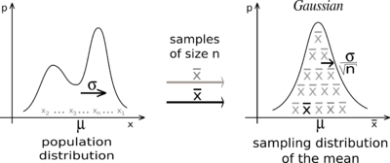
Central Limit Theorem
Shubham Thakur, Jaysen Shi, D. Wolfgang Herwald

Slide 2
A random person walks into a room, What is their blood pressure?

Slide 3
A number (n) of random people walk into a room, What is the average of their blood pressures?

Slide 4


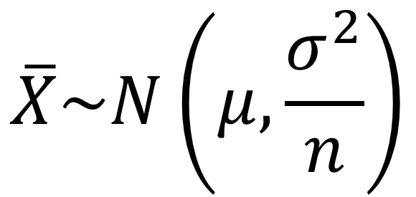

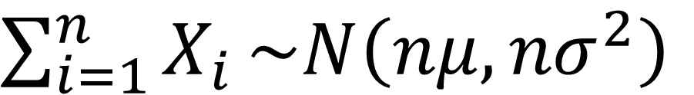



$$For a Random Sample i.e X_{1}, X_{2},…,X_{n} where all X_{i} are i.i.d$$
$$As n→∞$$
$$Sample Mean$$
$$Sample Variance$$
$$\overline{X}\sim N\left(μ,\frac{σ^{2}}{n}\right)$$
$\sum_{i=1}^{n}{X_{i}}\sim N\left(nμ,{nσ}^{2}\right)$
$$Population Mean$$
$$Sample Size$$
$$Sample Total$$

Slide 5
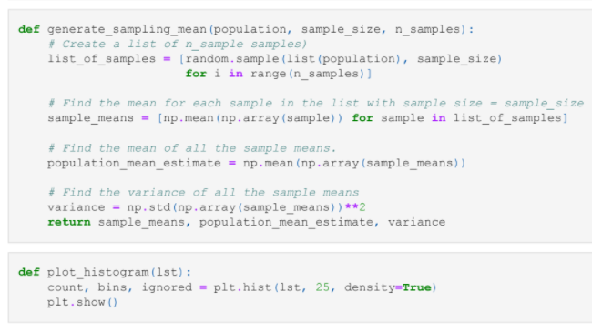





$$Population$$
$$List of Samples$$
$$Sample of Means$$
$$Population mean$$
$$estimate$$
$$Variance$$

Slide 6
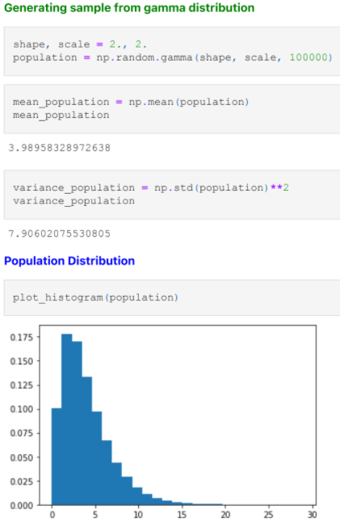
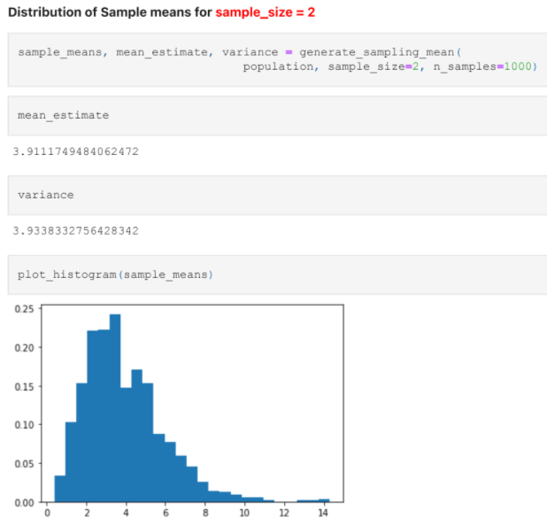
Gamma distribution

Slide 7
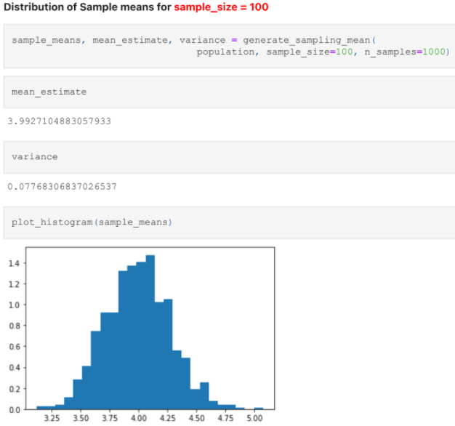
Gamma distribution

Slide 8
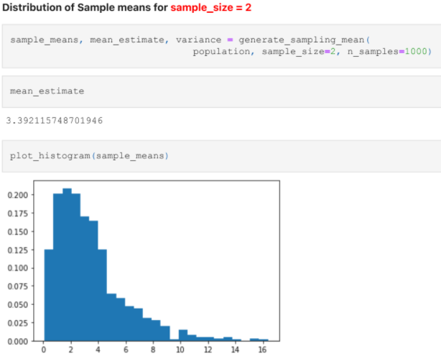
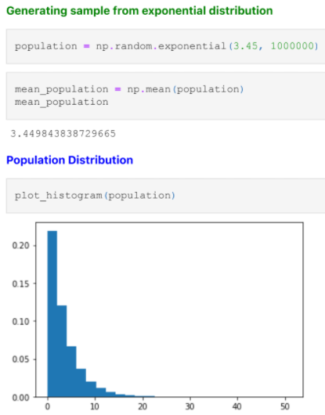
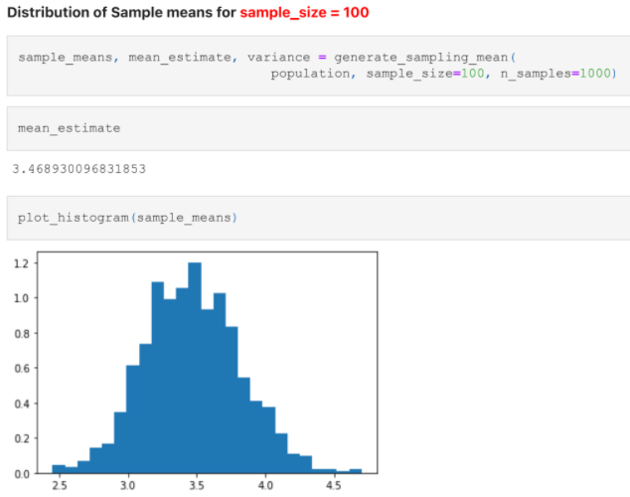
Exponential distribution

Slide 9
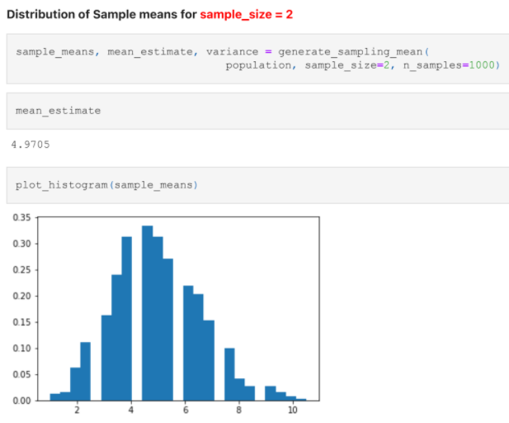
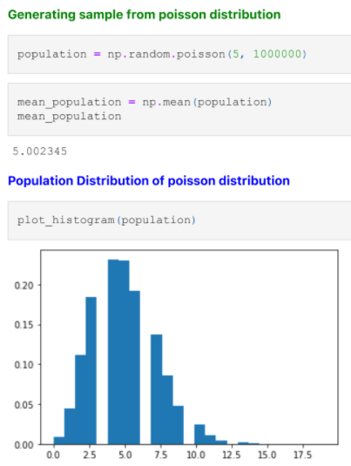
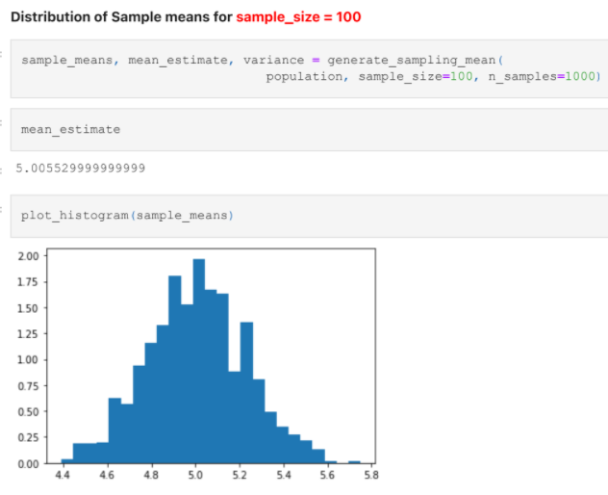
Poisson distribution

